Slide 1



Digital Marketing Assignment
Google Ads
Niharika Singh
BCA – 3rd Semester
Session – 2026 - 2027

Slide 2

Digital Marketing
Assignment Report
ASSIGNMENT FOLIO
Assignment Folio of
Digital Marketing
Submitted to
Dezyne École College
Toward Digital Marketing
By
BCA
3rd Semester
Niharika Singh
Dezyne École College
106/10, Civil Lines, Ajmer
www.dezyneecole.com
2026 - 2027

Slide 3
Digital Marketing
Assignment Report
ASSIGNMENT FOLIO
We take this opportunity to express our sincere gratitude to Dezyne École College for providing us with the knowledge, resources, and guidance essential to the successful completion of this project.
Our deepest thanks to our respected Principal, Dr. Vinita Mathur, for her visionary leadership and continuous encouragement. Her commitment to academic excellence and student growth has been a constant source of motivation and pride.
We are equally thankful to all our faculty members for their consistent support, expert advice, and valuable insights that shaped our learning and helped us achieve this milestone.
Lastly, we extend heartfelt thanks to everyone who directly or indirectly contributed to the success of this project.
We are proud to be part of Dezyne École College, an institution that truly nurtures professionalism, innovation, and purpose.
With sincere appreciation,
Niharika Singh,
Department – BCA
Dezyne École College, Ajmer

Slide 4
Digital Marketing
Case Study
ASSIGNMENT FOLIO
Objective:
Increase Website Traffic, Generate Quality Leads, Improve Brand Visibility, Boost Course Enrollments & Maximise ROI
1.Search Campaign Strategy
Targeted high-intent keywords related to computer courses.
2. Structure Ad Groups
Separate ad groups for each course to improve relevant and Quality Score.
3. Optimized Wix Landing Page
Mobile-friendly design with strong call-to-action buttons.
4. Conversion Tracking Setup
Measure form submission and call clicks for performance analysis.
5. Smart Bidding Strategy
Used "Maximize Conversions" to optimize ad spend automatically.

Slide 5

1.
2.
3.
Google Ads
Account Setup
Campaign Objective Selection
Campaign Types Selection
10.
4.
Conversion Tracking & Campaign Optimization
Campaign Setting Configuration
9.
5.
Ad &Creative Asset Creation
Location & Language Targeting
8.
7.
6.
Ad Group & Asset Structure
Keyword & Search Theme Setup
Budget & Bidding Strategy

Slide 6
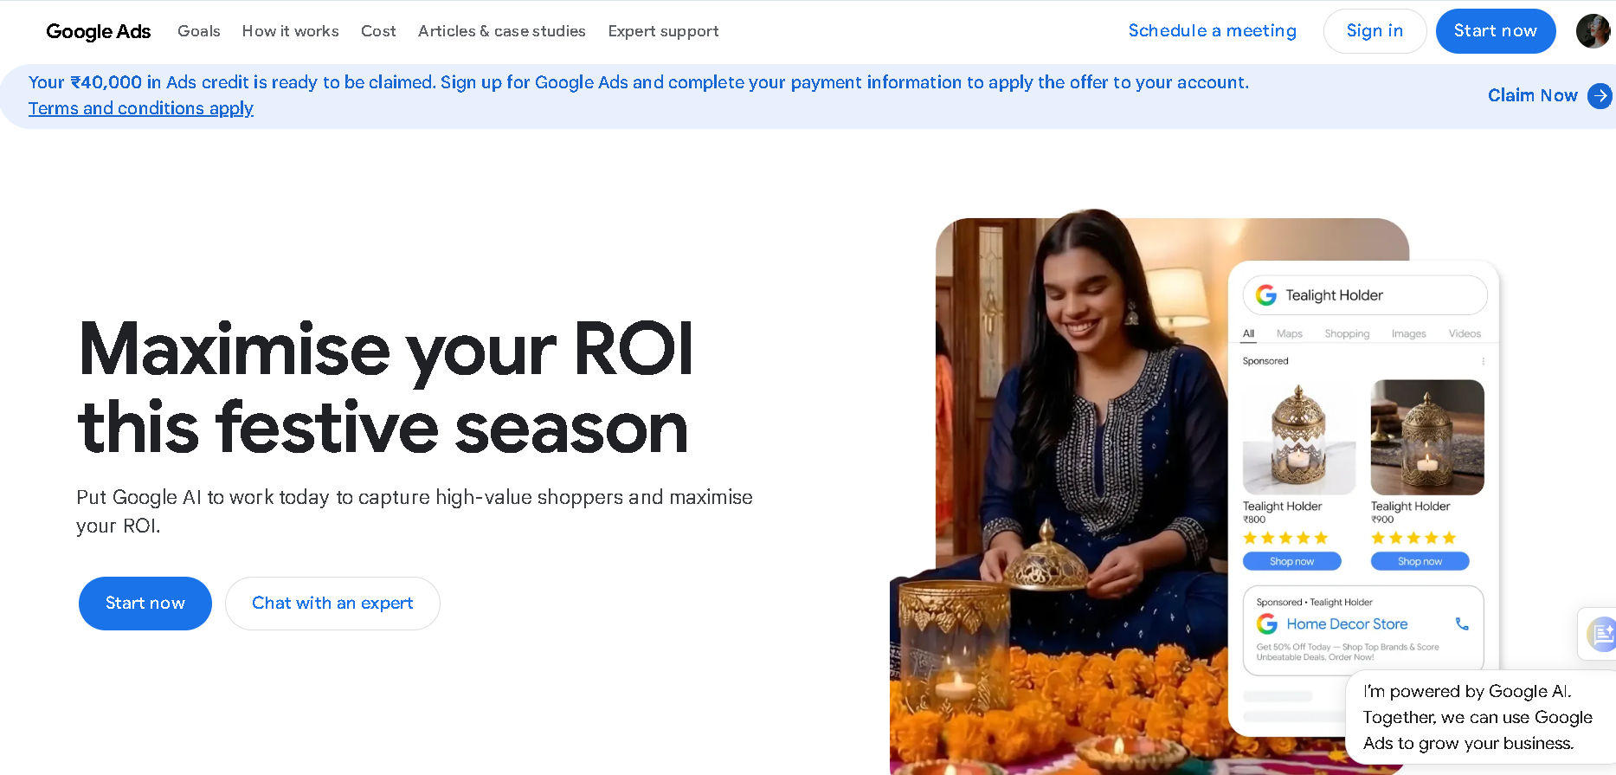
Google Ads Overview

Slide 7
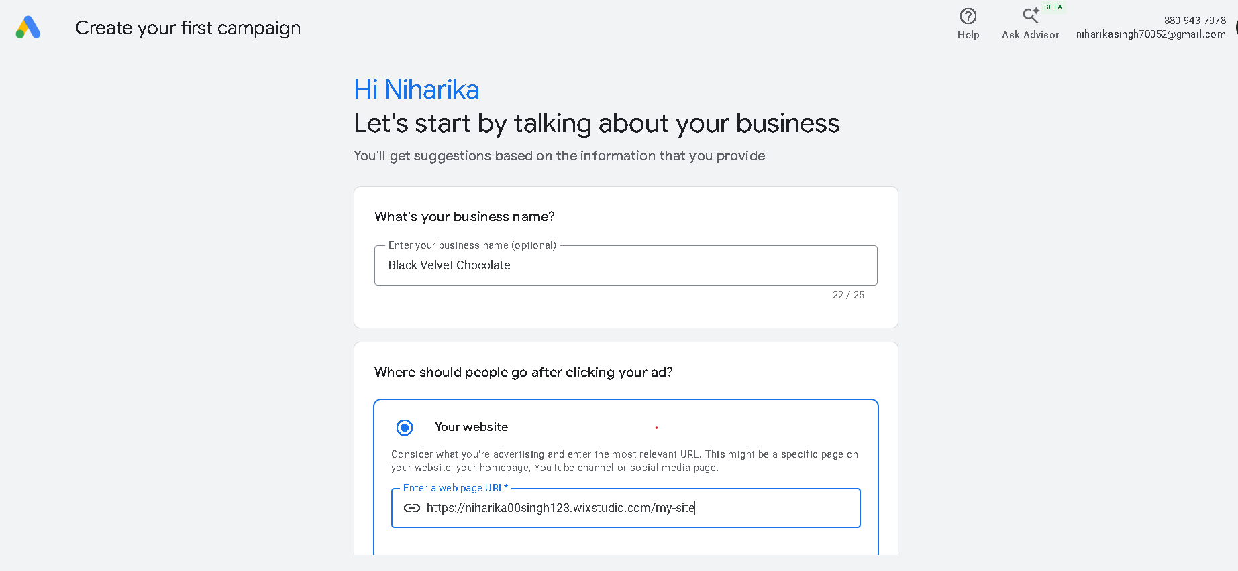
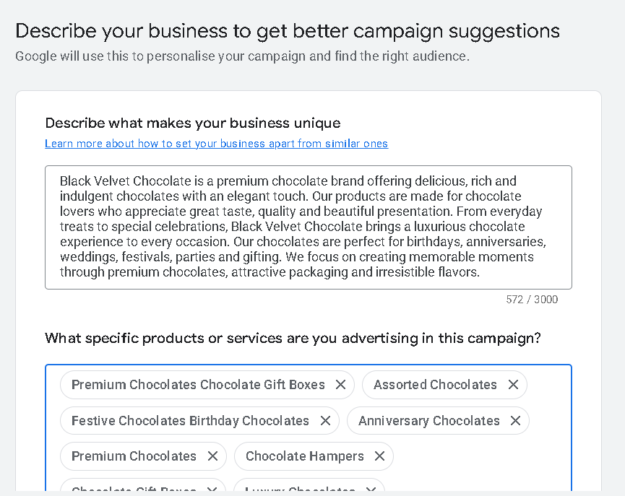
Google Ads Account Setup

Slide 8
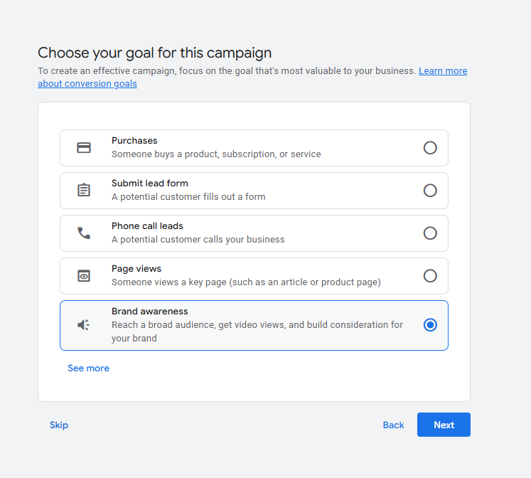
Google Ads Account Setup

Slide 9
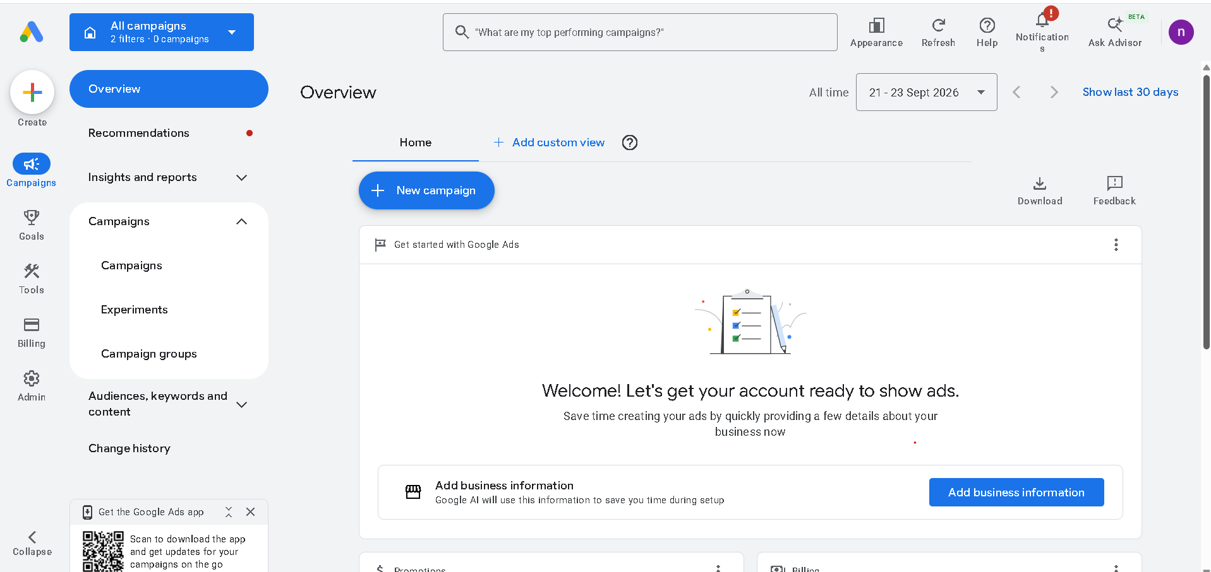
Google Ads Dash-Board

Slide 10
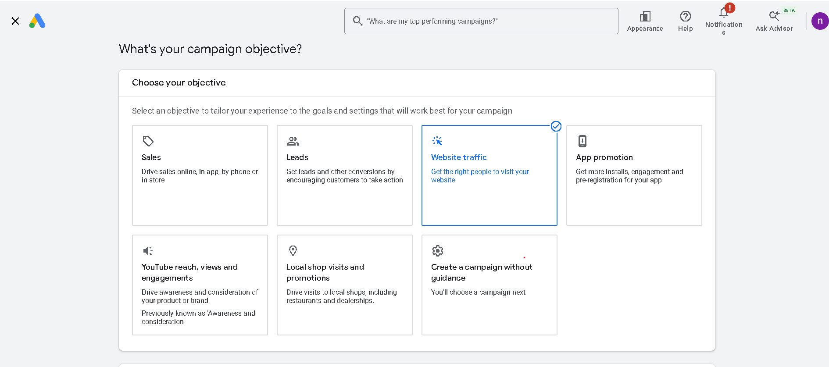
Campaign Objective

Slide 11
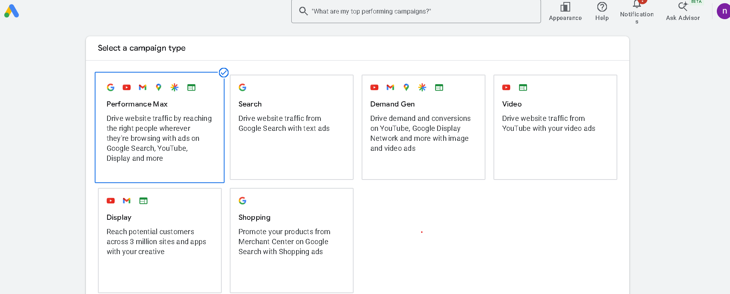
Campaign Types

Slide 12
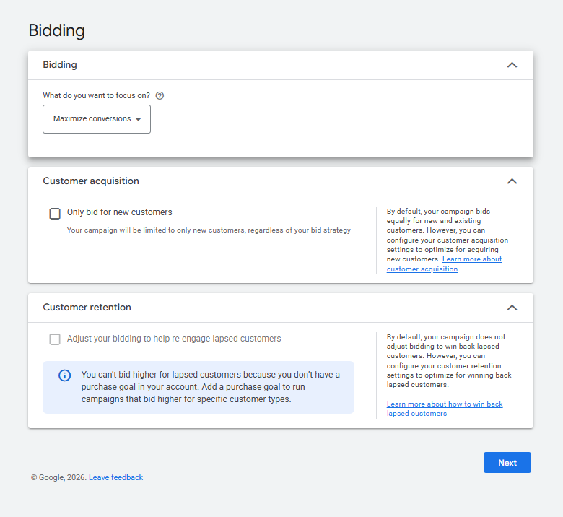
Bidding

Slide 13
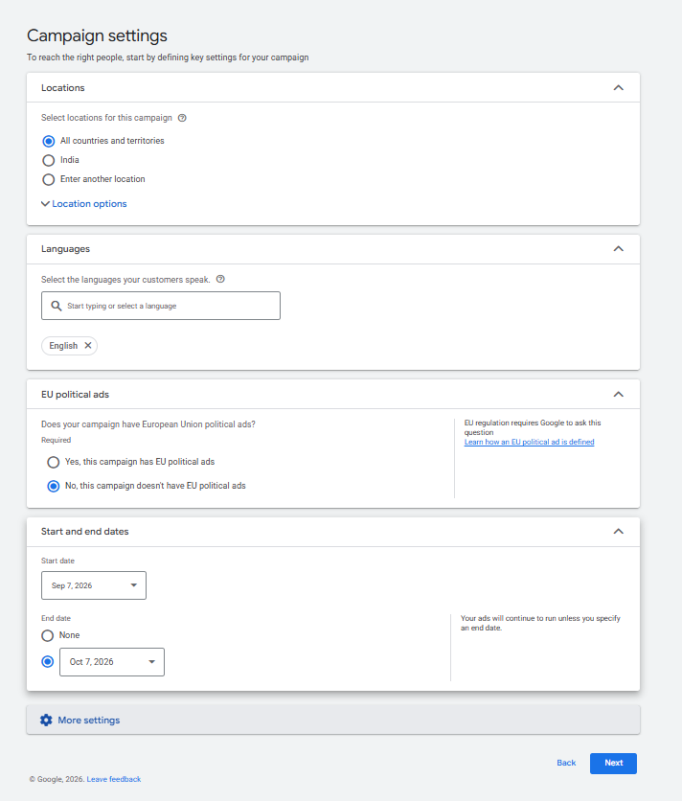
Campaign Setting : Location And Language

Slide 14
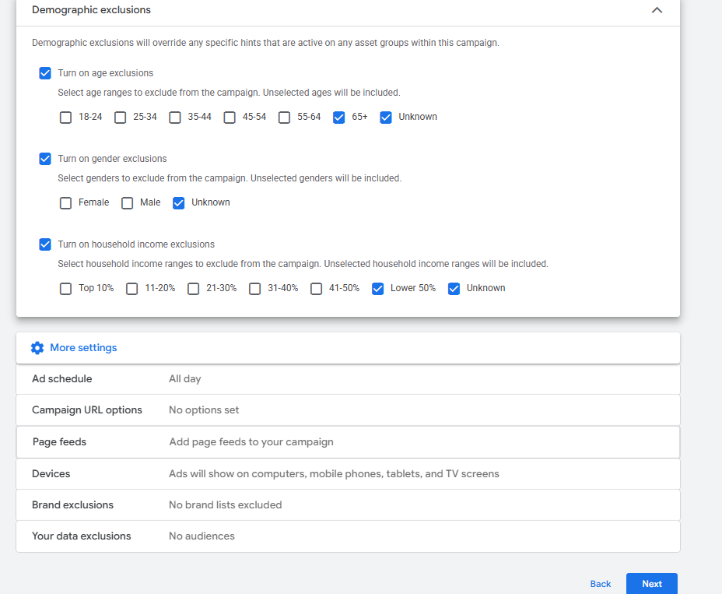
Campaign Setting

Slide 15
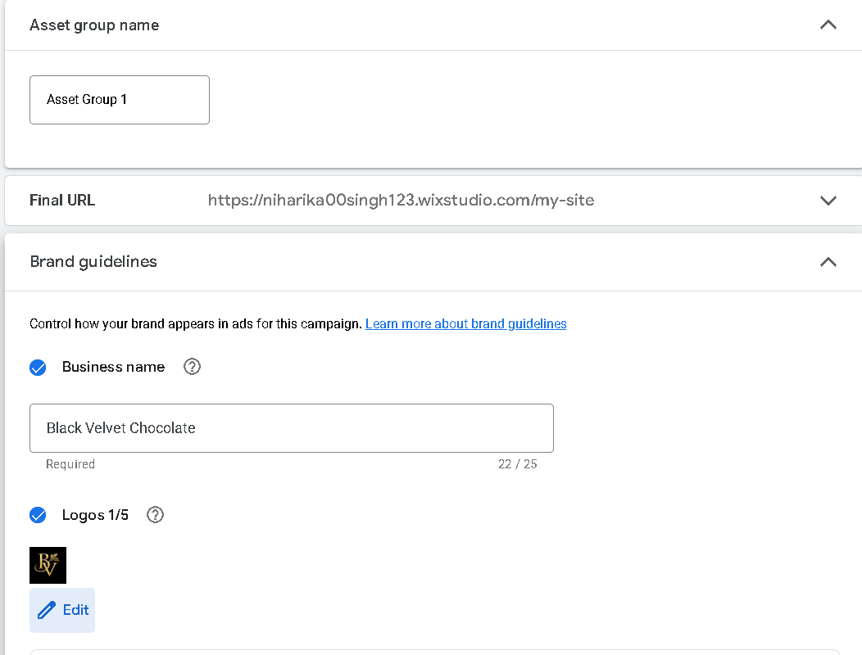
Campaign Setting :Asset Group

Slide 16
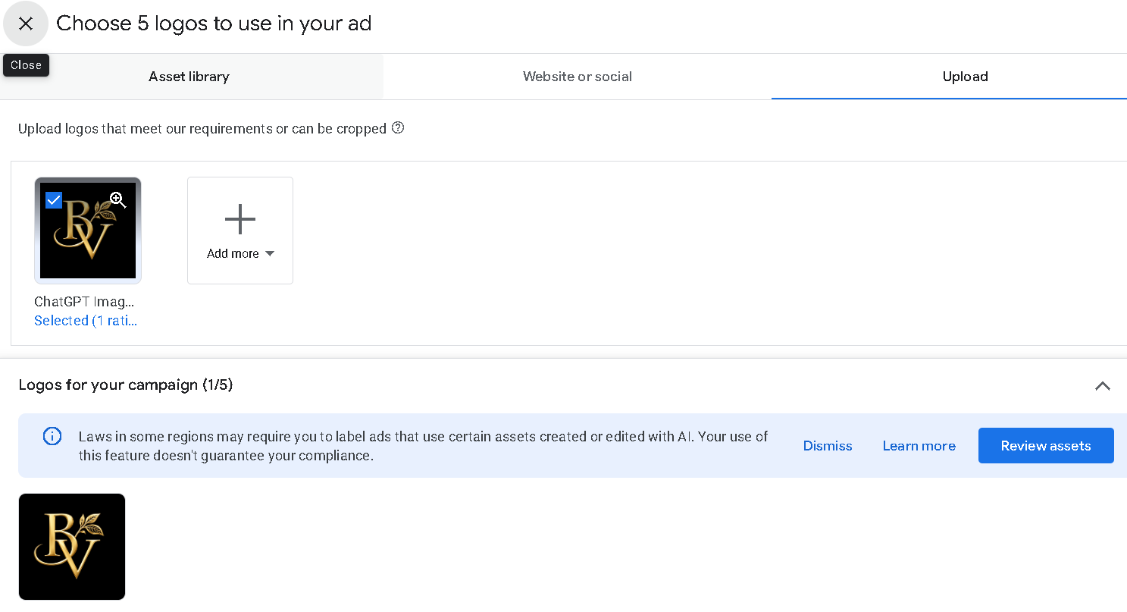
Campaign Setting :Asset Group

Slide 17
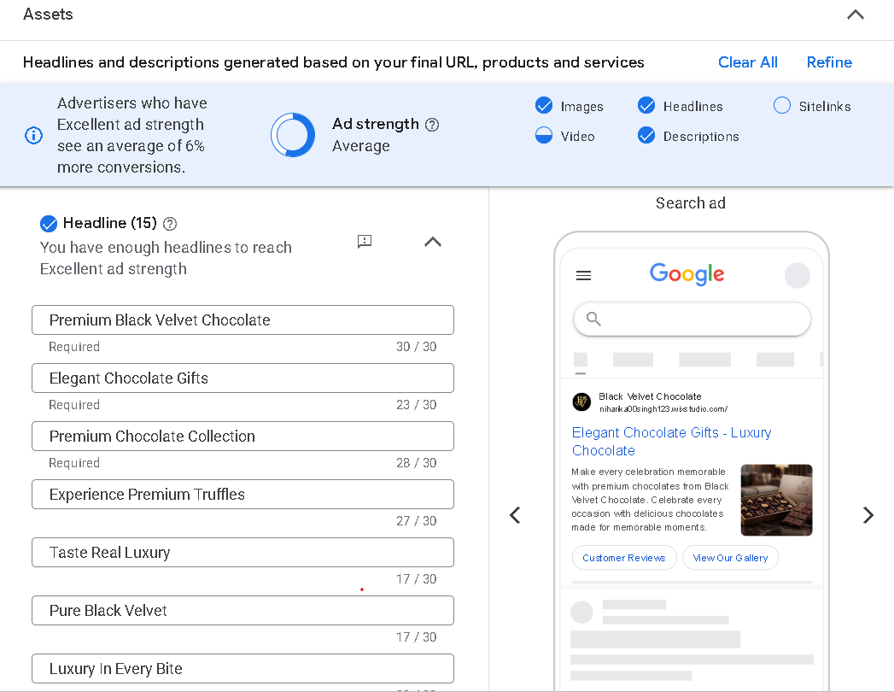
Campaign Setting :Asset Group

Slide 18
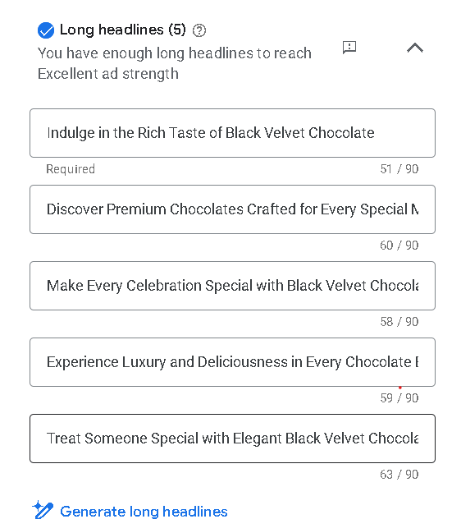
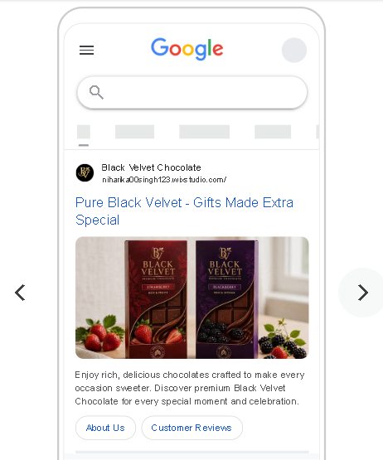
Campaign Setting :Asset Group

Slide 19
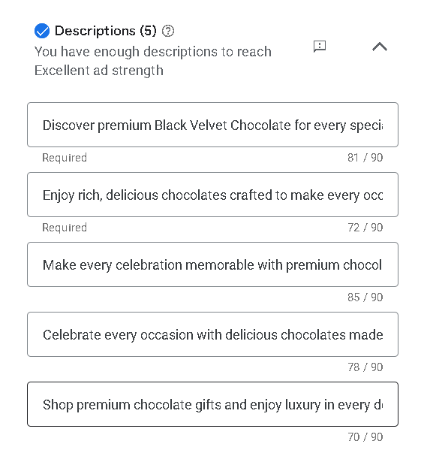
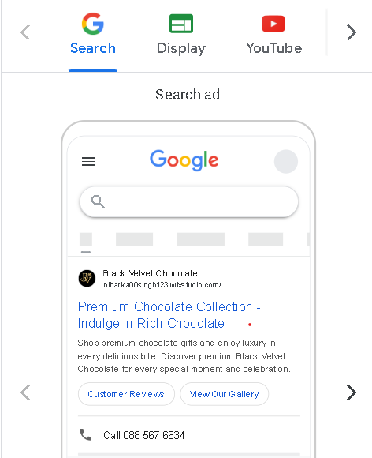
Campaign Setting :Asset Group

Slide 20
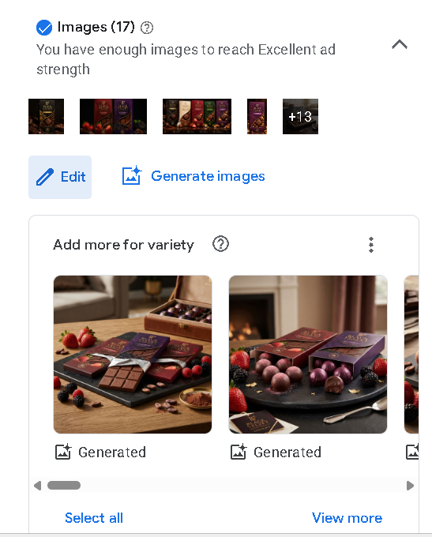
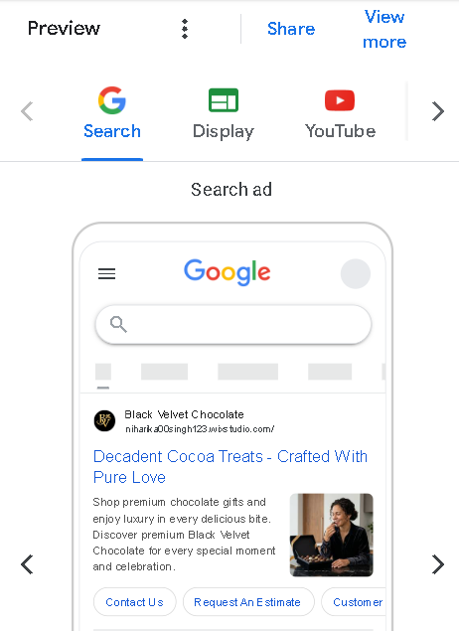
Campaign Setting :Asset Group

Slide 21
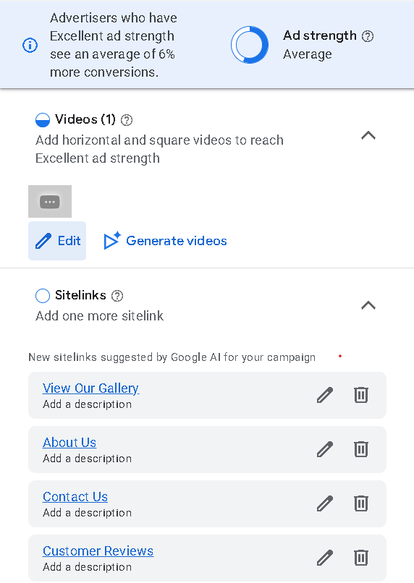
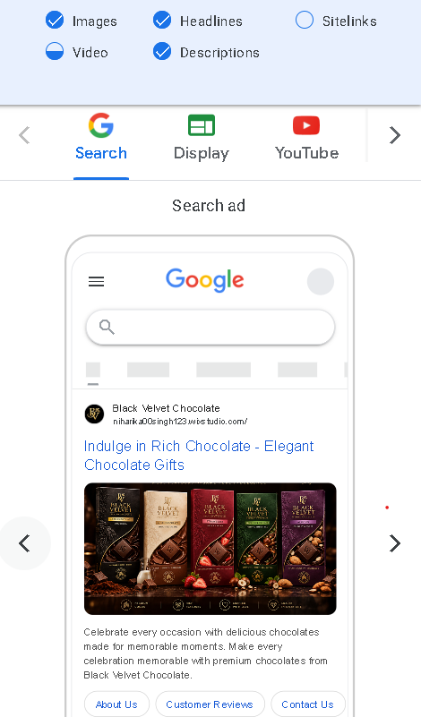
Campaign Setting :Asset Group

Slide 22
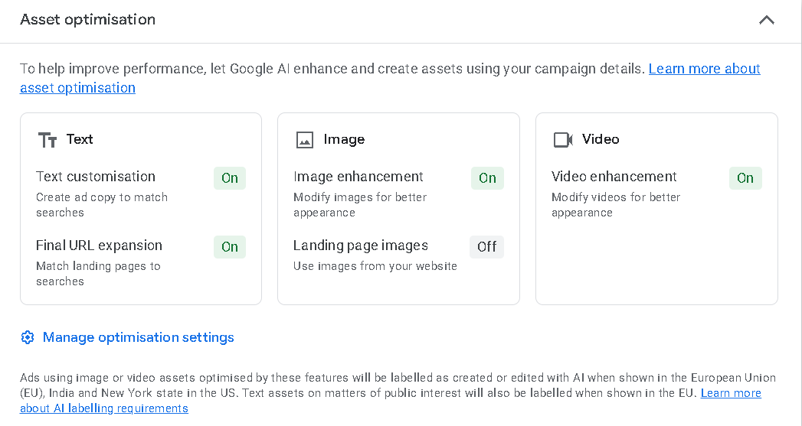
Campaign Setting :Signals

Slide 23
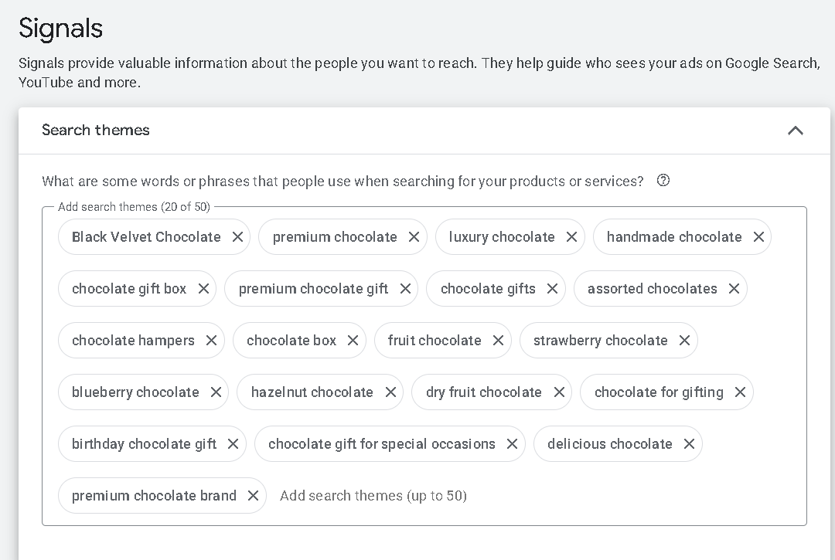
Campaign Setting : Signals

Slide 24
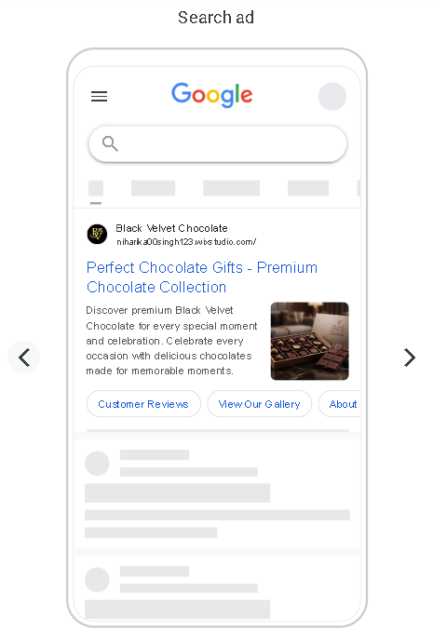
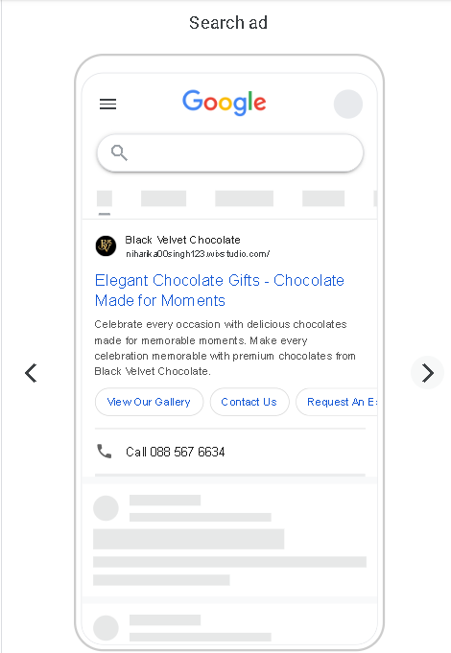
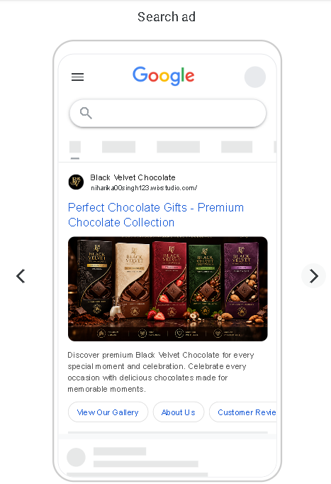
Ads Preview

Slide 25
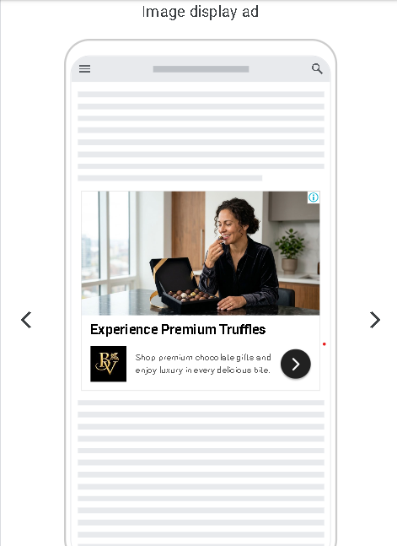
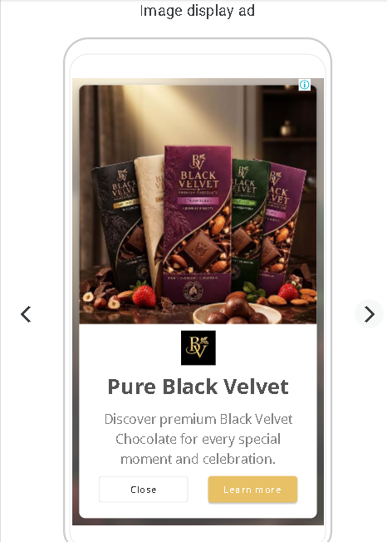
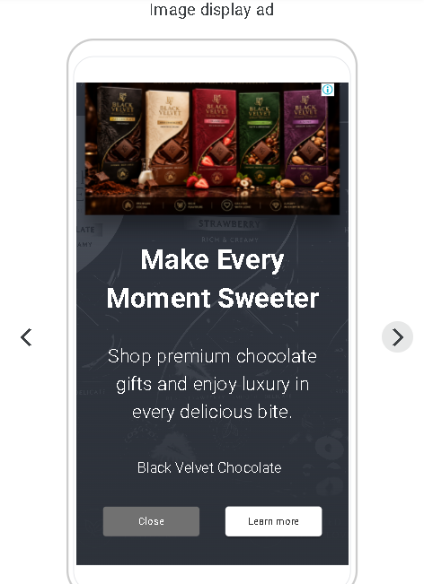
Ads Preview

Slide 26
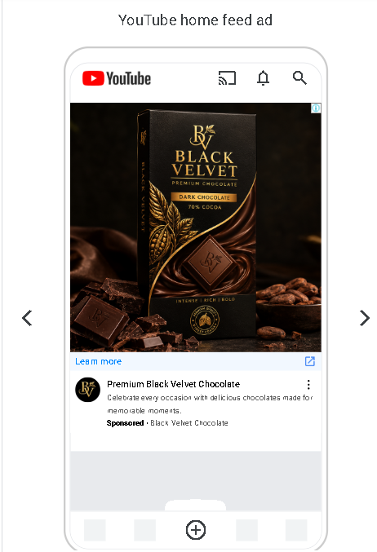
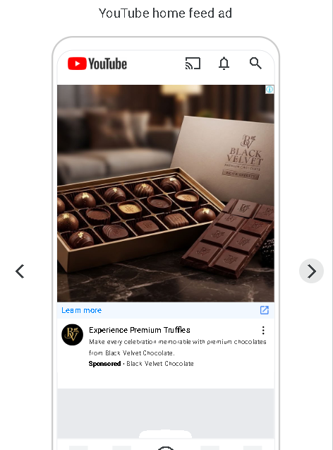
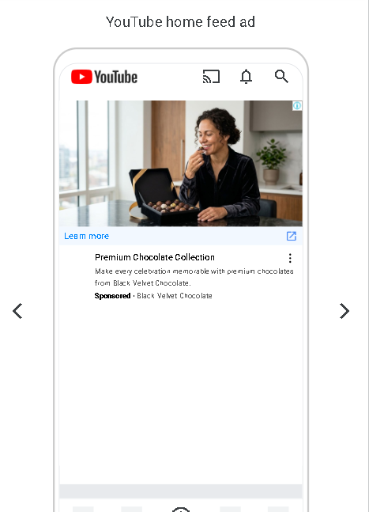
Ads Preview

Slide 27
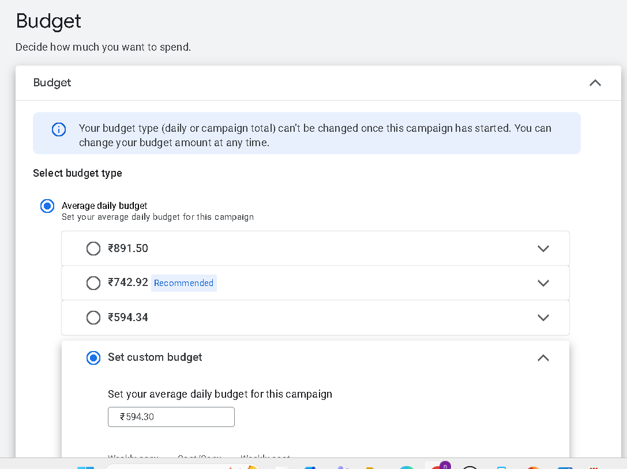
Google Ads Budget

Slide 28
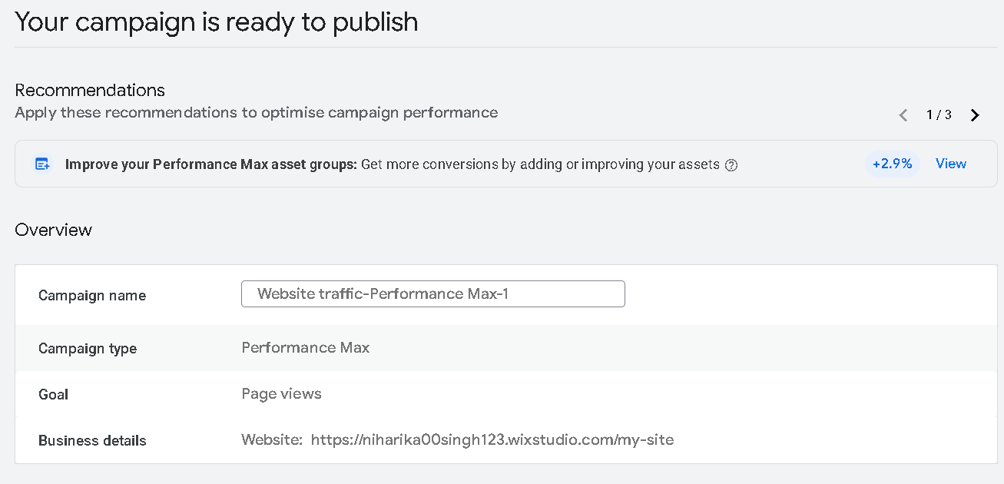
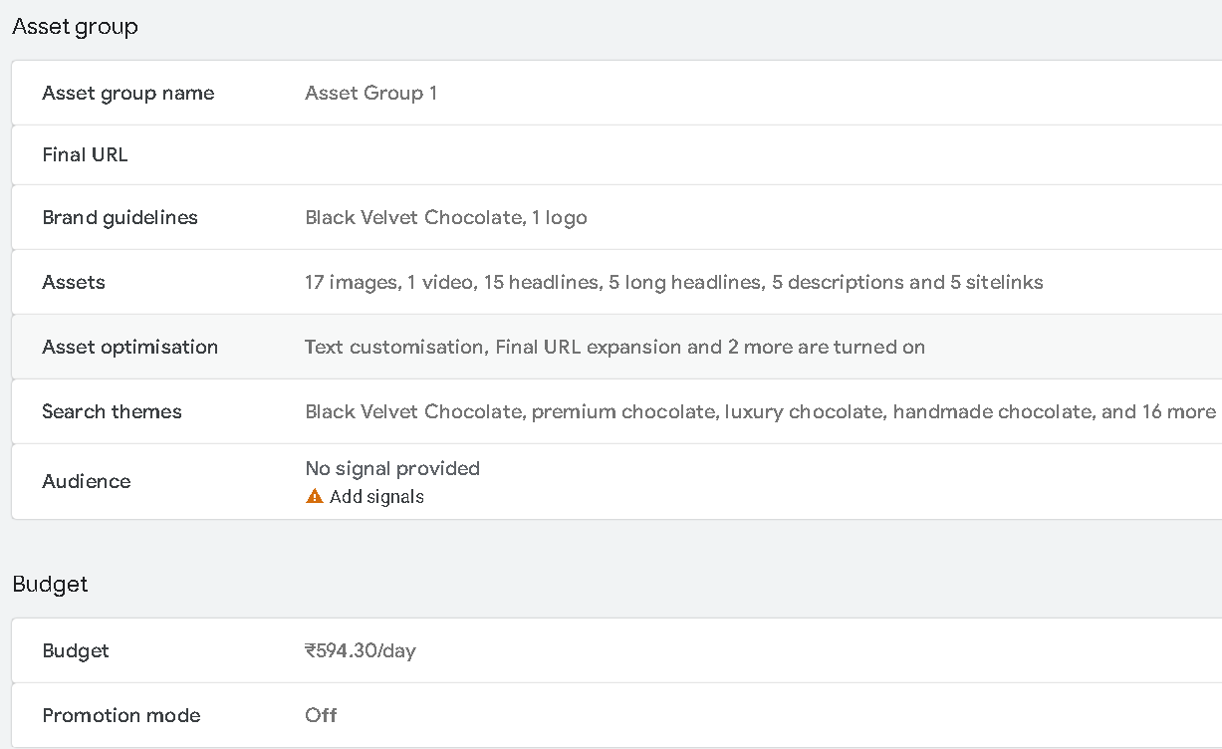
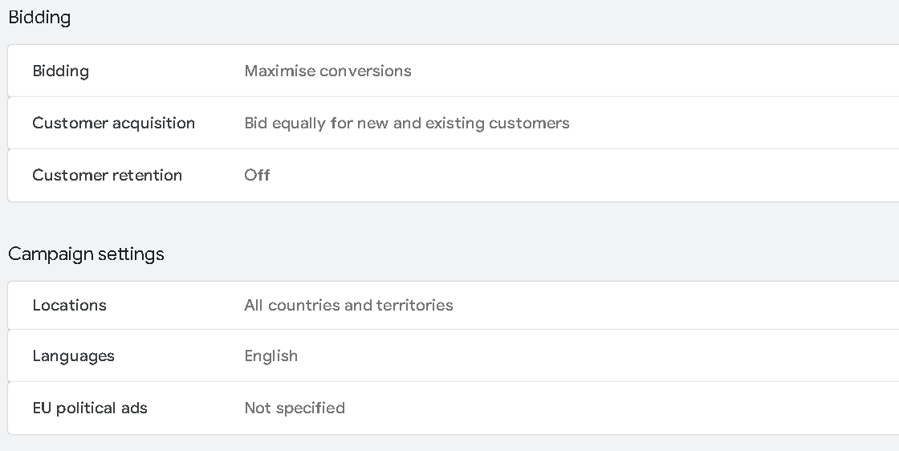
Google Ads Campaign Publication

Slide 29
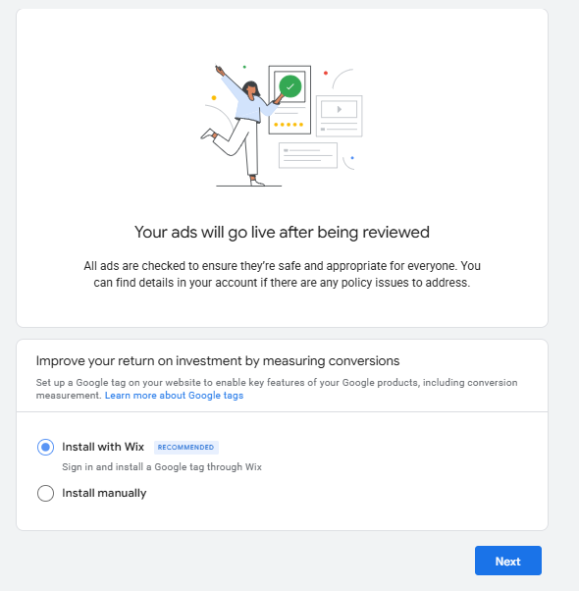
Google Ads Campaign Review

Slide 30
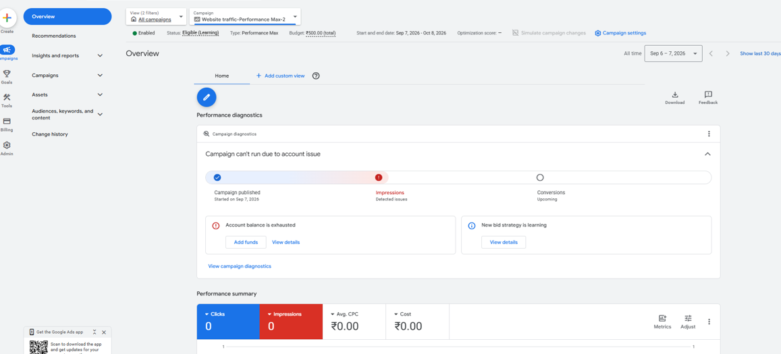
Campaign Dash-Board

